Slide 1
Using Crisis As An Opportunity
“You never change things by fighting the existing reality. To change something, build a new model that makes the existing model obsolete.”
--Buckminster Fuller

Slide 2
What Do We Know About The Covid Economy?
Some businesses and industries are faring much better than others. It’s better to own an auto mechanic shop than a hotel right now.
Some industries will have a much longer path back to “normal”
In industries that do go back to normal, parts of the business or sales cycle may change for a year or longer. For example, if you relied on conferences or networking events to generate new leads, you may need to build a new sales pipeline.

Slide 3
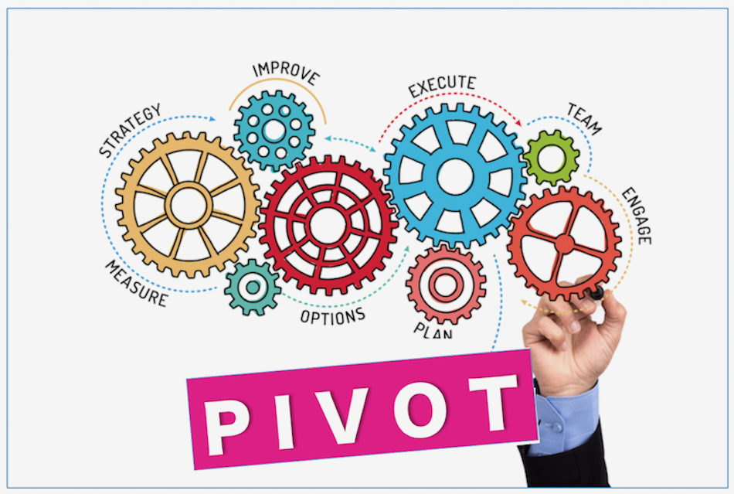
What Does It Mean To Pivot?
Take a hard look at your business. What are your core assets and opportunities? What has been disrupted the past 60 days that may continue to be disrupted for a year or more?
What losses can be cut? Is there a product line or service that won’t be in use again soon?
Follow the customers – how has their buying behavior changed?

Slide 4
Short-Term Pivots
Ledbury shifts shirt production line to make masks: https://richmondbizsense.com/2020/04/08/local-clothiers-shift-production-to-protective-masks/
Indevco shifts production to make PPE for health care workers: https://indevconorthamerica.com/indevco-north-america-shifts-production-of-house-wrap-to-isolation-gown-materials/

Slide 5
Long-Term Pivots
Fundamental change to sales, distribution, or production models.
Chesterfield Car Hauler To Build Home Delivery Service: https://richmondbizsense.com/2020/05/13/chesterfield-car-hauler-revs-up-5m-capital-raise-to-build-home-delivery-service/

Slide 6
Thinking Through Your Pivot
“Because the world is changing, we can never assume that the way we have done things in the past is adequate for the future.”
-- Yvon Chouinard
Question everything | Become a researcher | Explore alternate use cases

Slide 7
Question Everything
The best route to improvement is self-discovery. Ask yourself critical questions such as:
Are we solving for the right problem?
Is this the best use for our technology, product, or service?
Are we reaching our customers efficiently enough?
Are we generating maximum revenue?
Are we addressing the market properly?

Slide 8
Become A Researcher
Just like deciding initial strategy, a pivot should be based on data, experience, observation, and insight. Take note of industry victories. Take better notes on the failures.
Good resources:
https://www.fastcompany.com/
https://www.forbes.com/business/#1ace4d46535f
https://smallbiztrends.com/
Again, in observation you should keep questions in
mind like -- How can I make an impact? How do I
stay relevant? Can we do what they did?

Slide 9
Explore Alternate Use Cases
Burnout: the ugly side of problem-solving that innovators and entrepreneurs face regularly. Remember, bringing in a fresh perspective never hurts.
Survey your digital network – ask open questions
Consult with people who have no opinion of your industry
Re-frame the problem you are trying to solve: Is there an opportunity to better serve a market you had never considered before?

Slide 10
If They Did It, So Can You
Gap started as a San Francisco-area record store that sold Levi’s.
PayPal began as a company making security software for handheld devices.
Wrigley originally used chewing gum as an incentive for customers to buy their baking powder.
YouTube was a video dating site.

